Slide 1
Deep Learning Final Project
SemanticDiffGAN
Date：2023/06/14
Members :
R26111010 黃韋晧 RE6111040 楊淳先
RE6111032 曾以諾 NN6114027 陳皙蔆

Slide 2
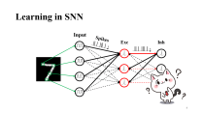
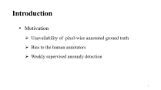
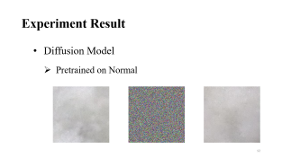
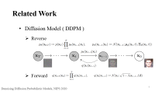
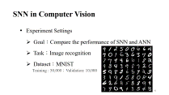
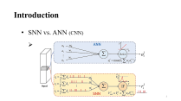
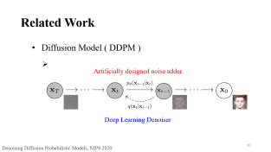
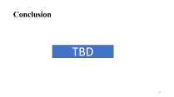
Outline
Introduction
Related Work
Proposed Method
Experiment Result

Slide 3
Introduction
Motivation
Unavailability of pixel-wise annotated ground truth
Bias to the human annotators
Weakly supervised anomaly detection

Slide 4
Introduction
Goal
Diffusion models on anomaly detection
Approach | GAN & Autoencoder
Shortage | Complicated to train Difficult to preserve fine details in the image

Slide 5
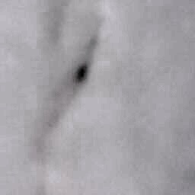
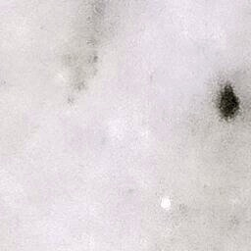
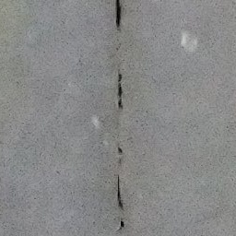

Introduction
Dataset
Marble Surface Anomaly Detection
Classes | Crack, Dot, Joint And Good
# of Train set | 2249
# of Test set | 688
Crack, Dot
Joint, Good
https://www.kaggle.com/datasets/wardaddy24/marble-surface-anomaly-detection-2

Slide 6
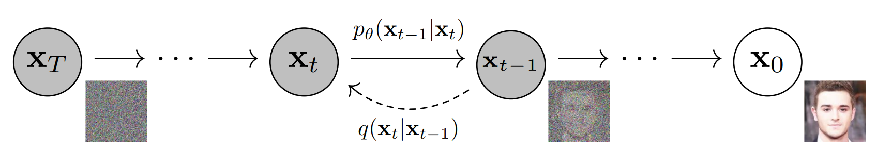
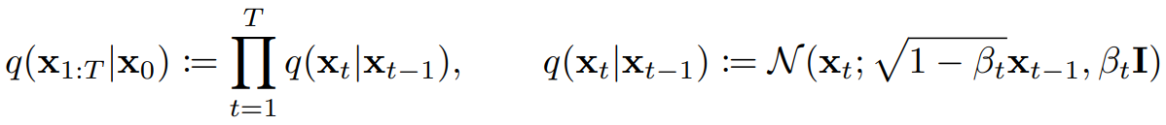
Related Work
Diffusion Model ( DDPM )
Reverse
Forward
Denoising Diffusion Probabilistic Models, NIPS 2020

Slide 7
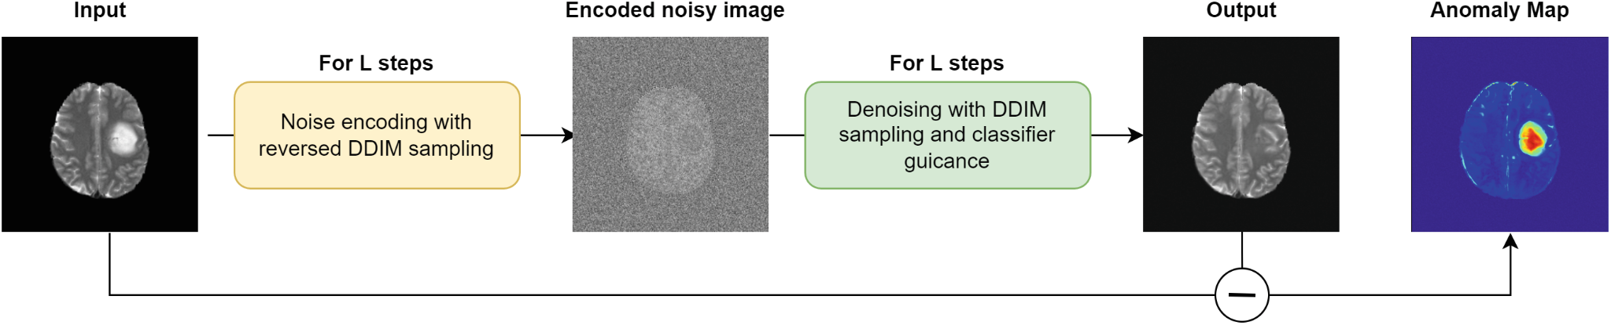
Related Work
Another noise
Anomaly Detection with Denoising Diffusion Probabilistic Models using Simplex Noise, CVPR 2022

Slide 8
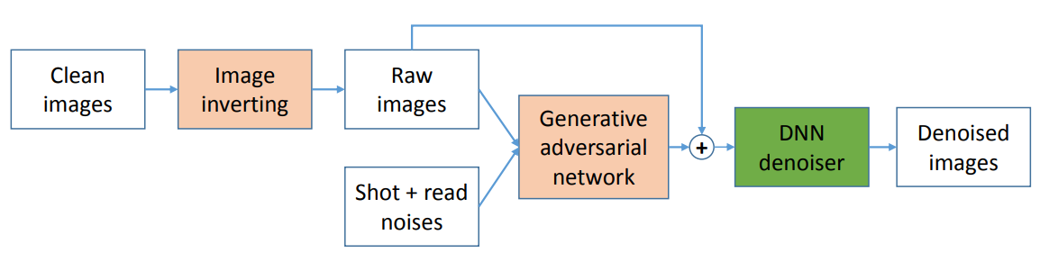
Related Work
Generated Noise
GAN-based Noise Model for Denoising Real Images, ACCV 2020

Slide 9
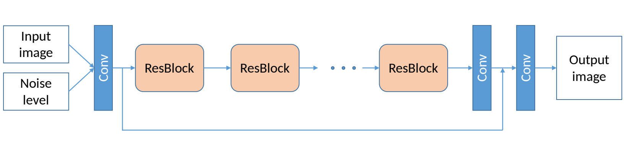
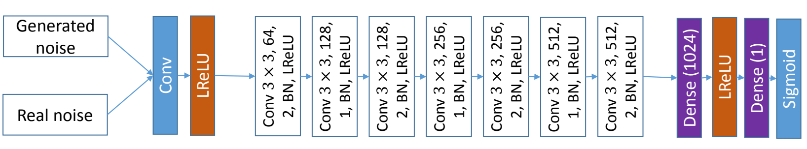
Related Work
Generated Noise
GAN-based Noise Model for Denoising Real Images, ACCV 2020

Slide 10
Related Work
Diffusion Model ( DDPM )
Artificially designed noise adder
Deep Learning Denoiser
Denoising Diffusion Probabilistic Models, NIPS 2020

Slide 11
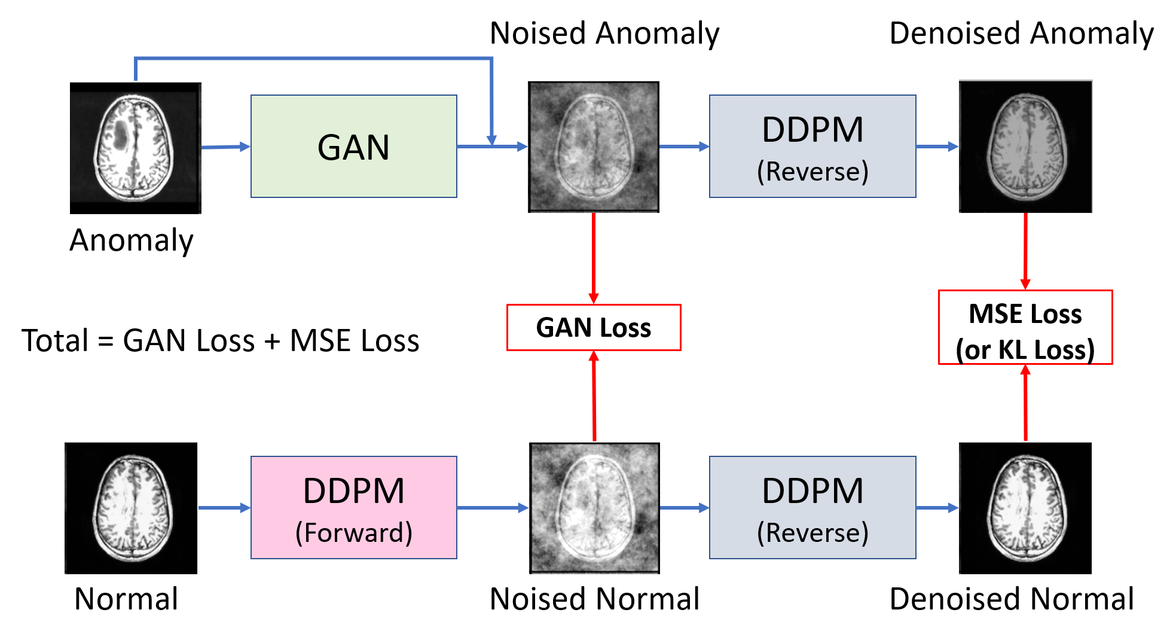
Proposed SemanticDiffGAN
Overview

Slide 12



Experiment Result
Diffusion Model
Pretrained on Normal

Slide 13
Experiment Result
Setting
learning rate = 0.0005
Batch Size = 16
Epochs=5

Slide 14
Proposed SemanticDiffGAN
Overview

Slide 15
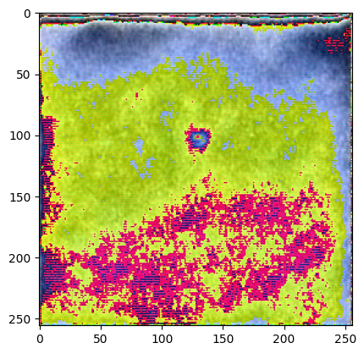
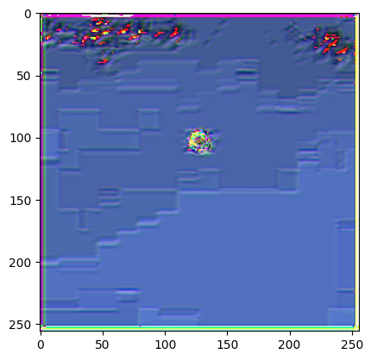

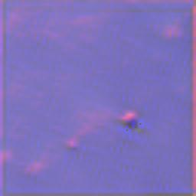
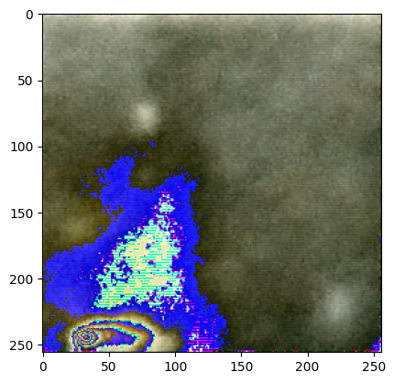
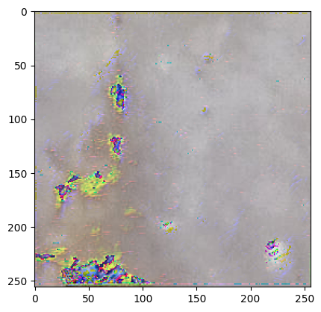
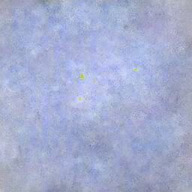
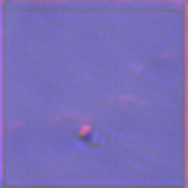
Experiment Result
SemanticDiffGAN
Denoised / Noised

Slide 16
Proposed SemanticDiffGAN
Overview

Slide 17
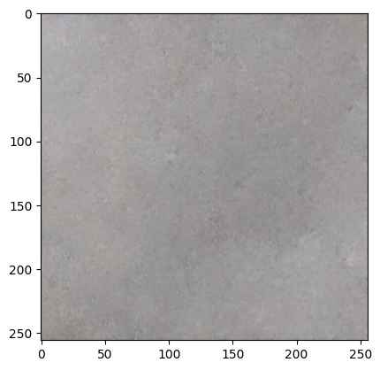
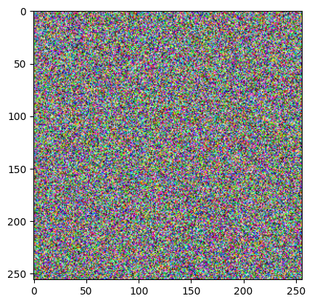
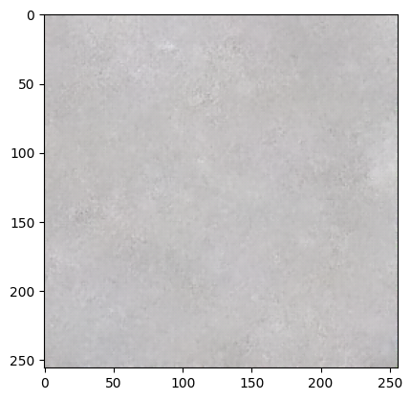
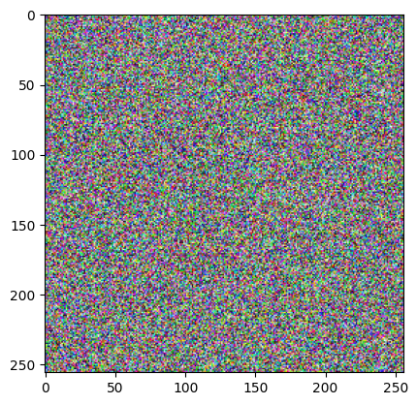
Experiment Result
SemanticDiffGAN
Denoised / Noised

Slide 18
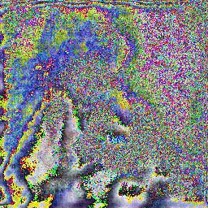
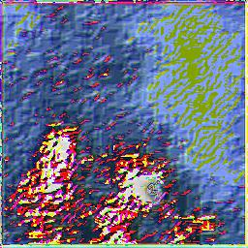
Experiment Result
Small Data
Training Strategy
Model Design
Fail Cases
Denoised Anomaly / Noised

Slide 19
THE END
Thank you for listening

